Slide 1


SMART CANTEEN SYSTEM
PRESENTED BY
RAJEV SHREE U [2303811710422130]
ROHINI D [2303811710422131]
SAGANA S [2303811710422134]
SINDHUJA S [2303811710422150]
SUPERVISOR
MRS. V. KALPANA, M.E,(Ph.D).,

Slide 2

PRESENTATION OVERVIEW
Problem Identification
Architecture diagram
Modules
Module description
Diagrams
Output
Conclusion

Slide 3
PROBLEM IDENTIFICATION
Smart canteen systems aim to solve problems like long queues, inefficient order management, food wastage due to poor inventory, and manual data processing. Challenges in implementing these systems include high initial costs, the need for reliable technology access (like smartphones and internet), potential security breaches, difficulties in achieving user adoption, and the necessity of ongoing system maintenance and updates.

Slide 4
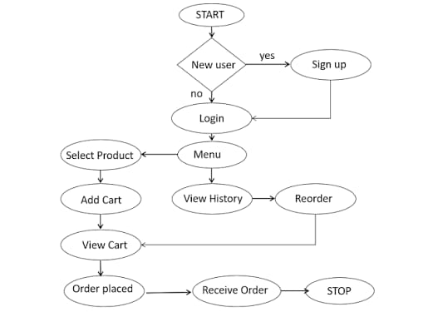
ARCHITECTURE DIAGRAM

Slide 5
MODULES
Login and Role Selection Module
Menu Management Module (Admin Side)
Customer Ordering Module
Cart and Billing Module
Order Management Module (Admin Side)
Configuration and Data Storage Module

Slide 6
MODULE DESCRIPTION
1. Login and Role Selection Module: This module helps to identify whether the user is a Customer or an Admin.Customers can directly go to the order page, while the admin needs to enter a password to manage menu and orders.It controls who can access which part of the system.
2. Menu Management Module (Admin Side): In this module, the Admin can add, edit, or delete food items in the menu.Each food item has details like name, price, meal type (Breakfast/Lunch/Dinner), and category (Veg/Non-Veg).This helps the admin keep the menu updated every day.
3.Customer Ordering Module: This module allows Customers to see the available menu, select items, and add them to the cart.After selecting, the customer can choose the payment method and confirm the order.It makes the food ordering process simple and fast.

Slide 7
MODULE DESCRIPTION
4. Cart and Billing Module: This module shows the list of selected food items, quantity, and total price.It also displays the estimated preparation time before confirming the order.It helps customers review their order before payment.
5. Order Management Module (Admin Side): This module is used by the Admin to see all customer orders.The admin can mark the orders as Ready or Delete them after completion.It helps the canteen staff to manage and deliver orders properly.
6. Configuration and Data Storage Module: This module stores all data like menu, orders, and admin password in the browser using local storage.It also lets the admin set canteen name, opening, and closing time.This keeps the system data safe even after closing the browser.

Slide 8
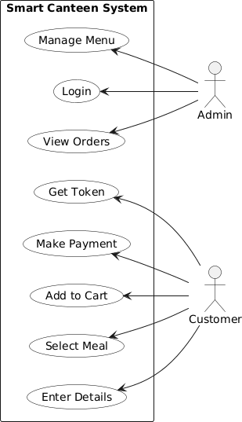
USE CASE DIAGRAM

Slide 9
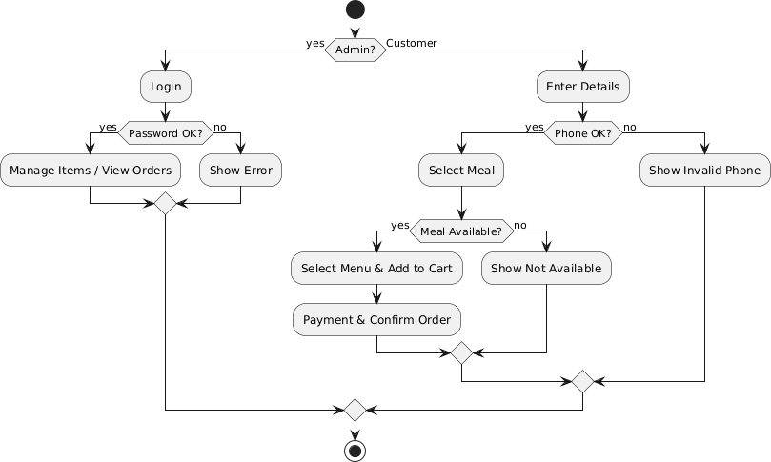
ACTIVITY DIAGRAM

Slide 10
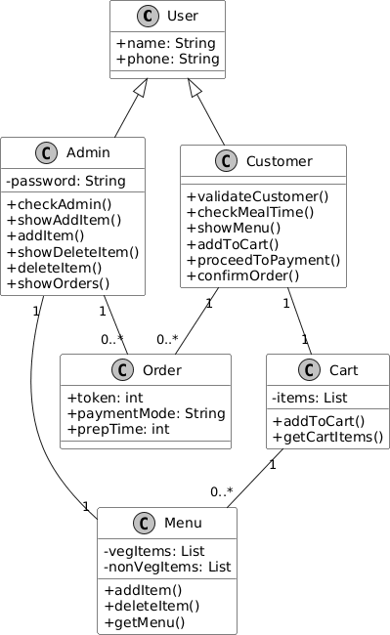
CLASS DIAGRAM

Slide 11
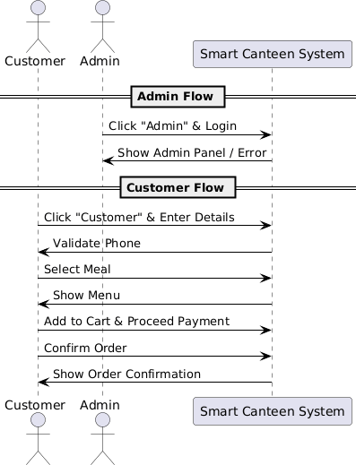
SEQUENCE DIAGRAM

Slide 12
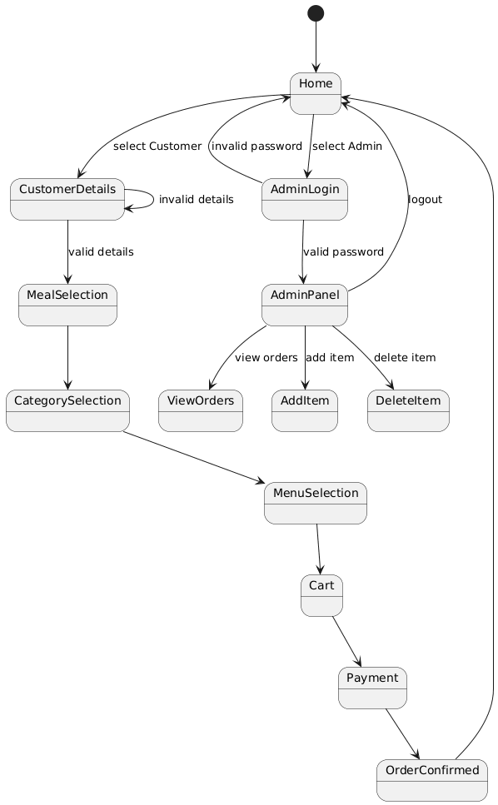
STATE MACHINE DIAGRAM

Slide 13
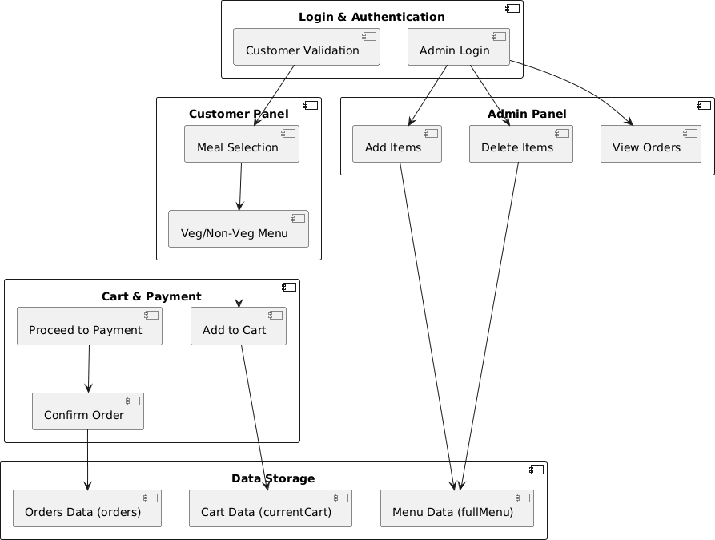
COMPONENT DIAGRAM

Slide 14
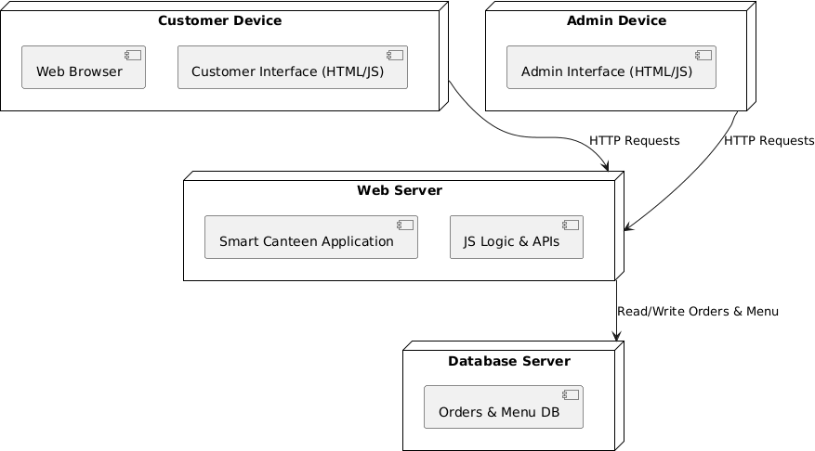
DEPLOYMENT DIAGRAM

Slide 15
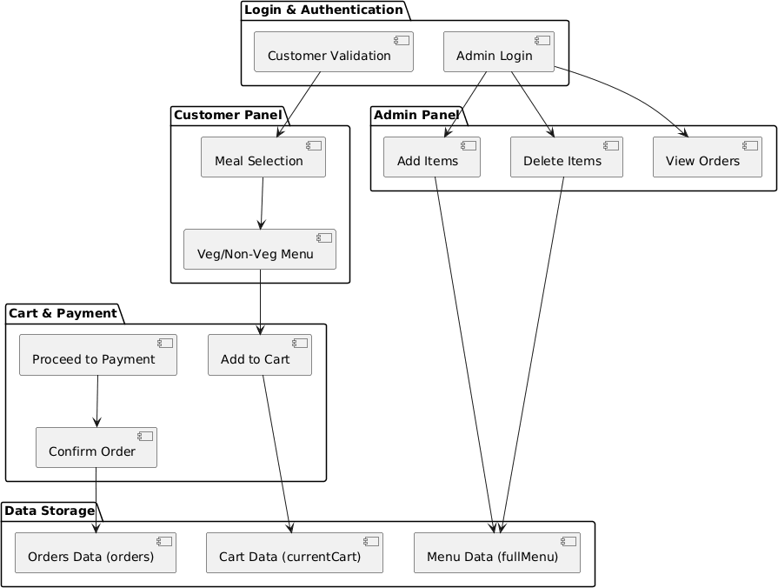
PACKAGE DIAGRAM

Slide 16
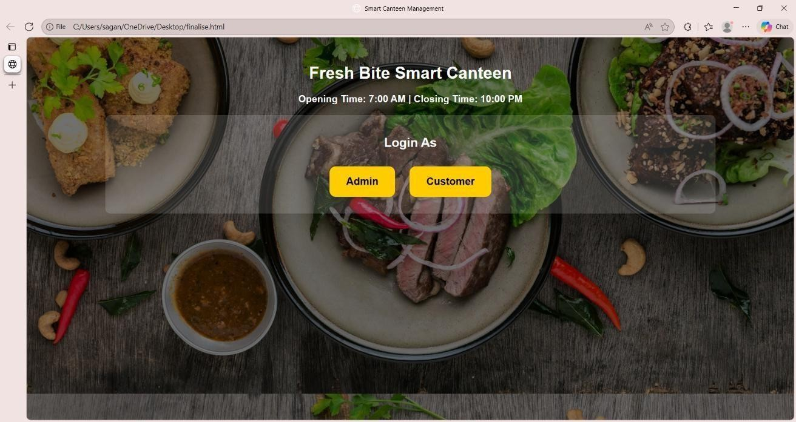
OUTPUT
1. USER LOGIN

Slide 17
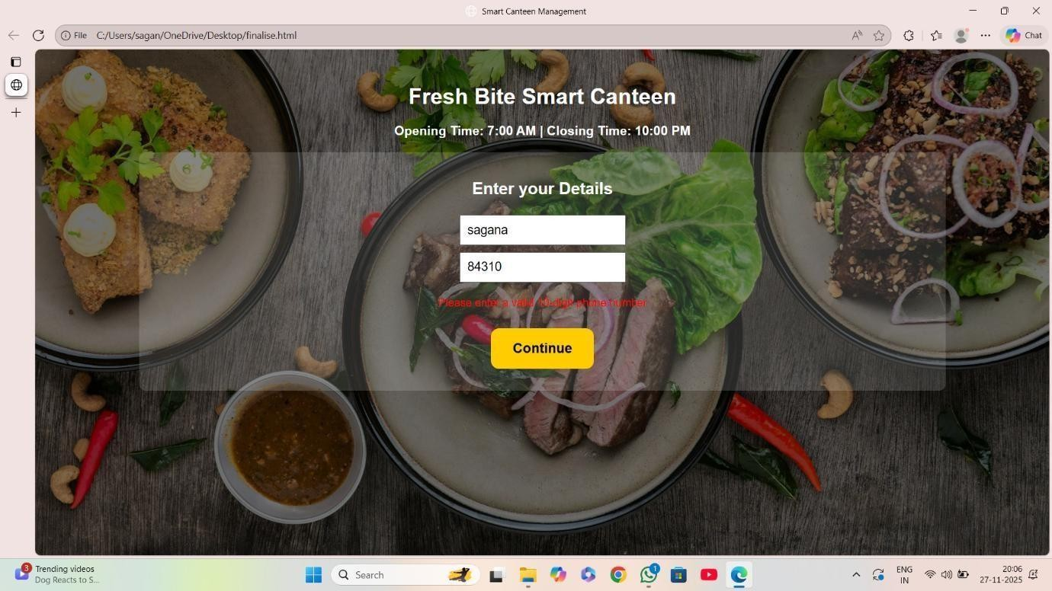
OUTPUT
2. USER DETAILS

Slide 18
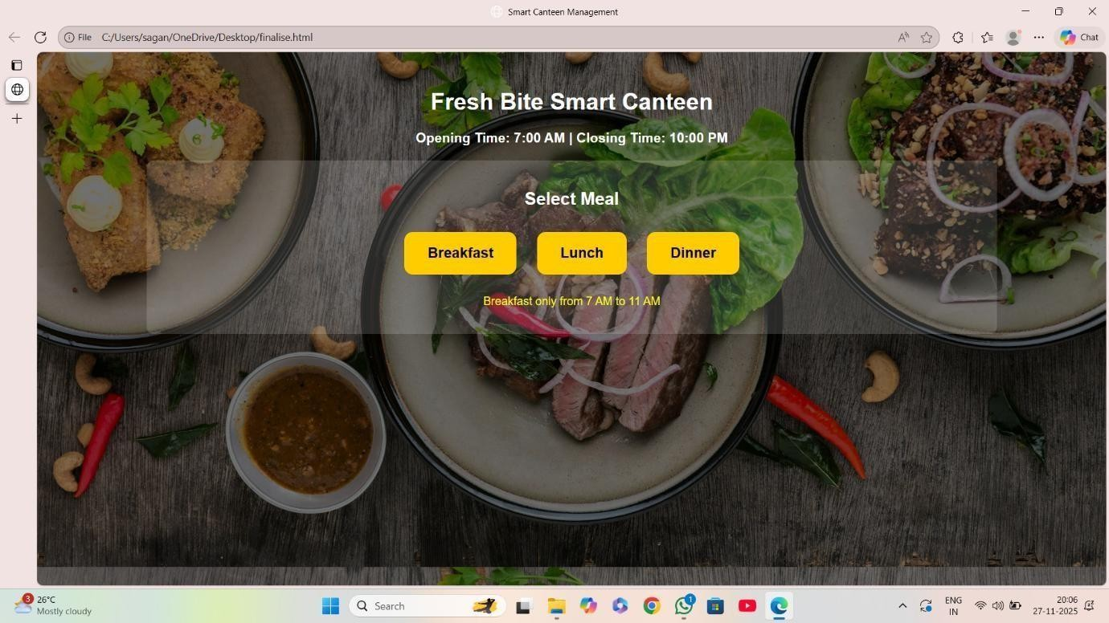
OUTPUT
3. SELECT MEAL

Slide 19
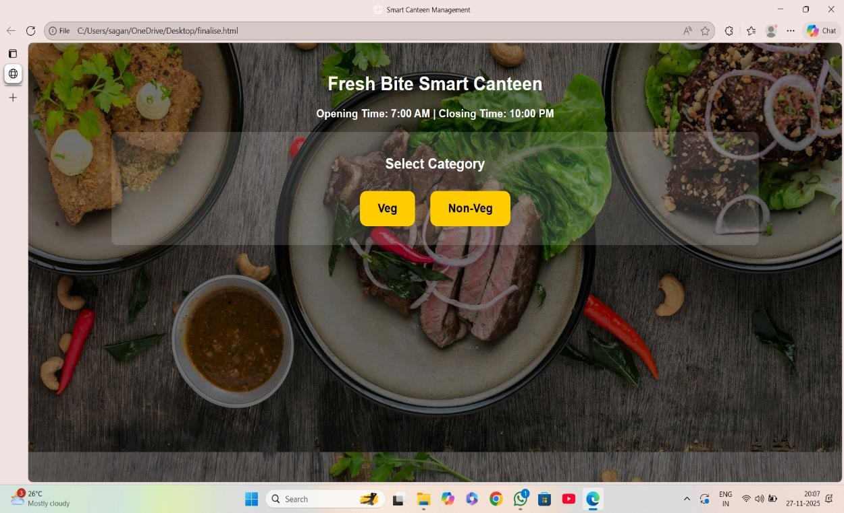
OUTPUT
4. SELECT CATEGORY

Slide 20
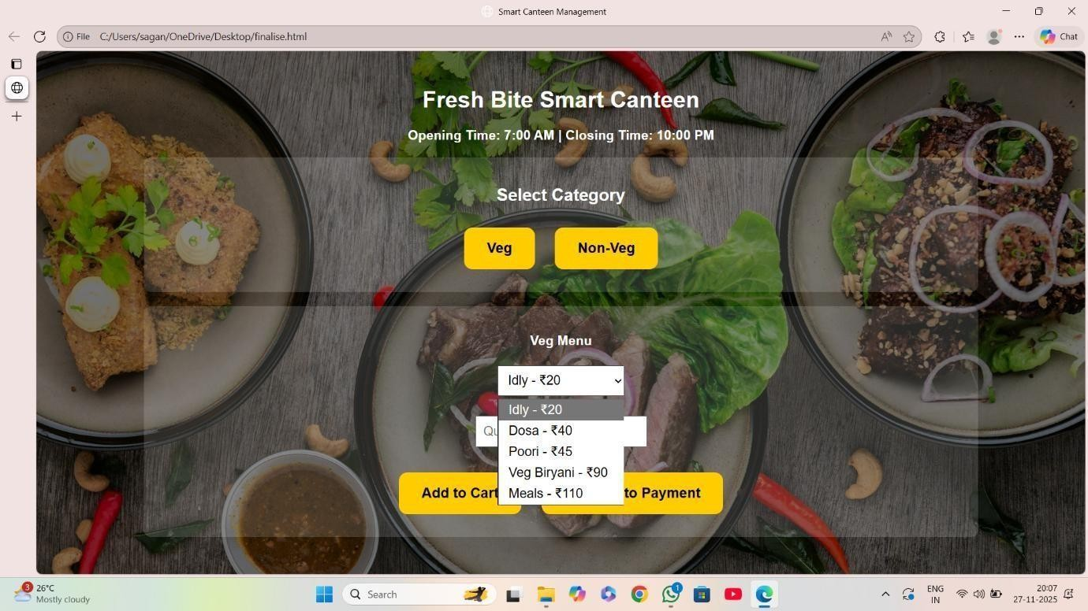
OUTPUT
5. SELECT DISHES

Slide 21
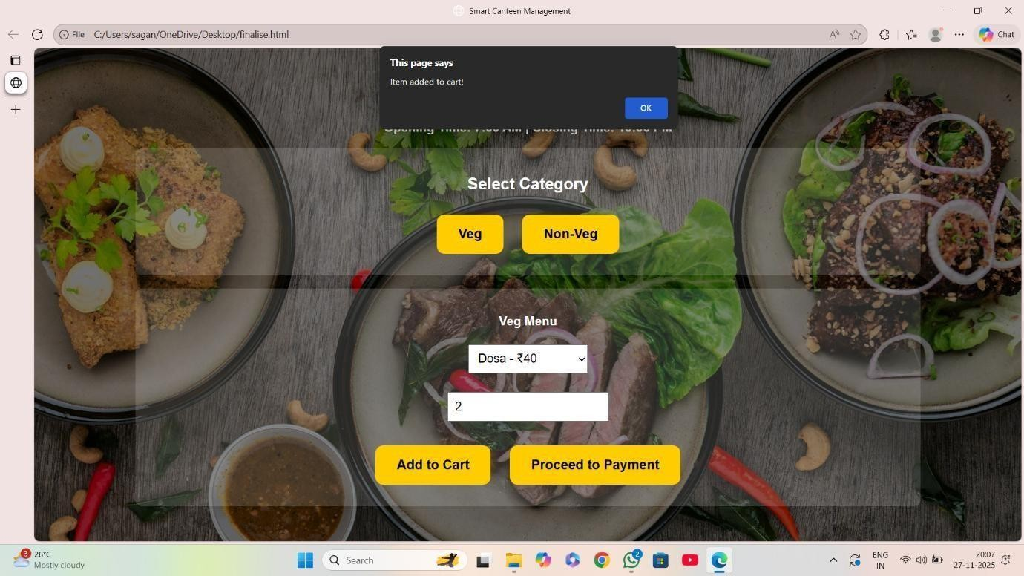
OUTPUT
6. ADD TO CART

Slide 22
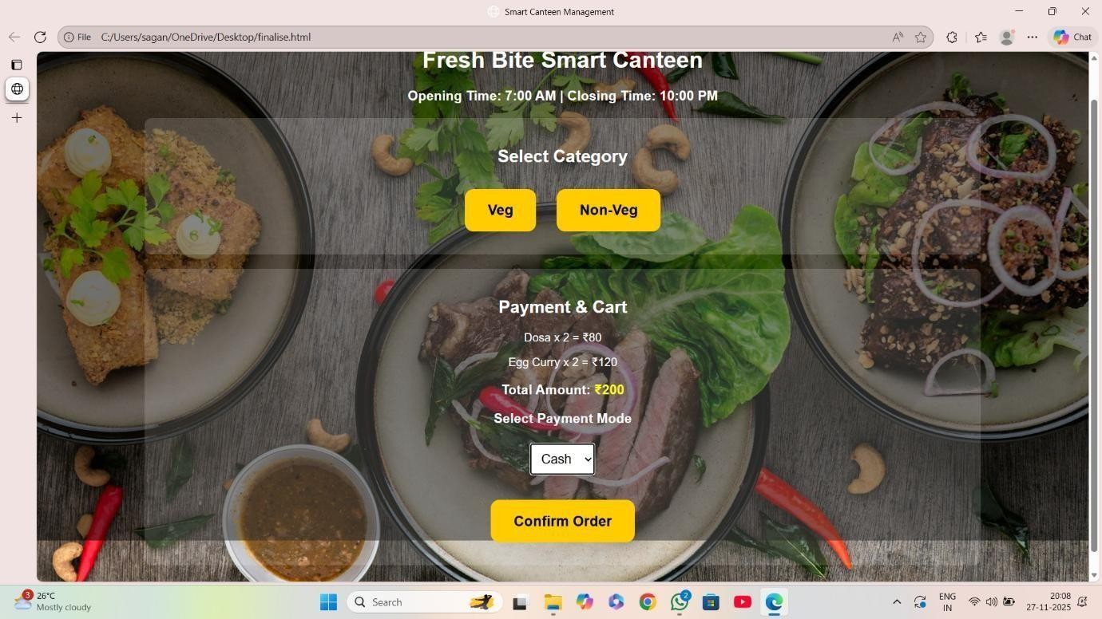
OUTPUT
7. PAYMENT

Slide 23
OUTPUT
8. CONFIRM ORDER

Slide 24
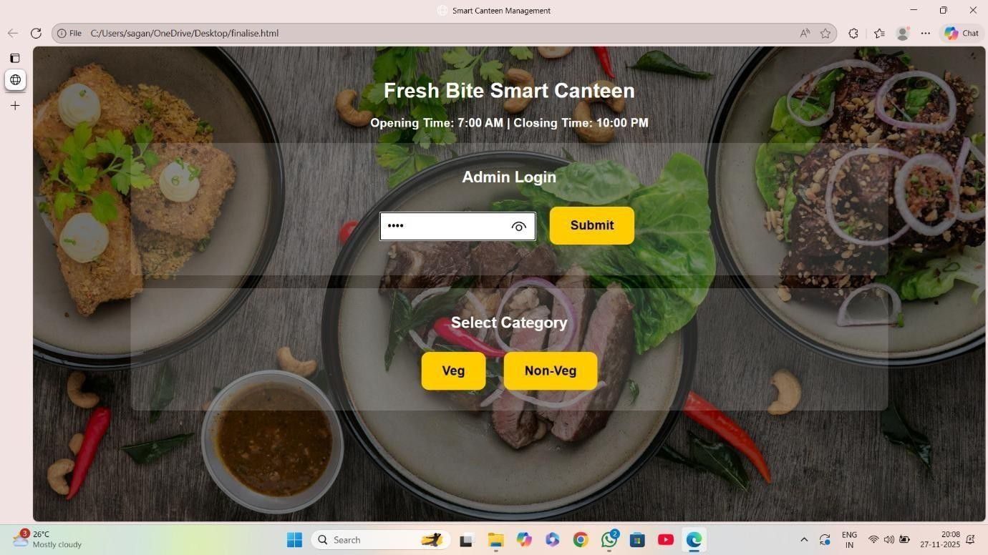
OUTPUT
9. ADMIN LOGIN

Slide 25
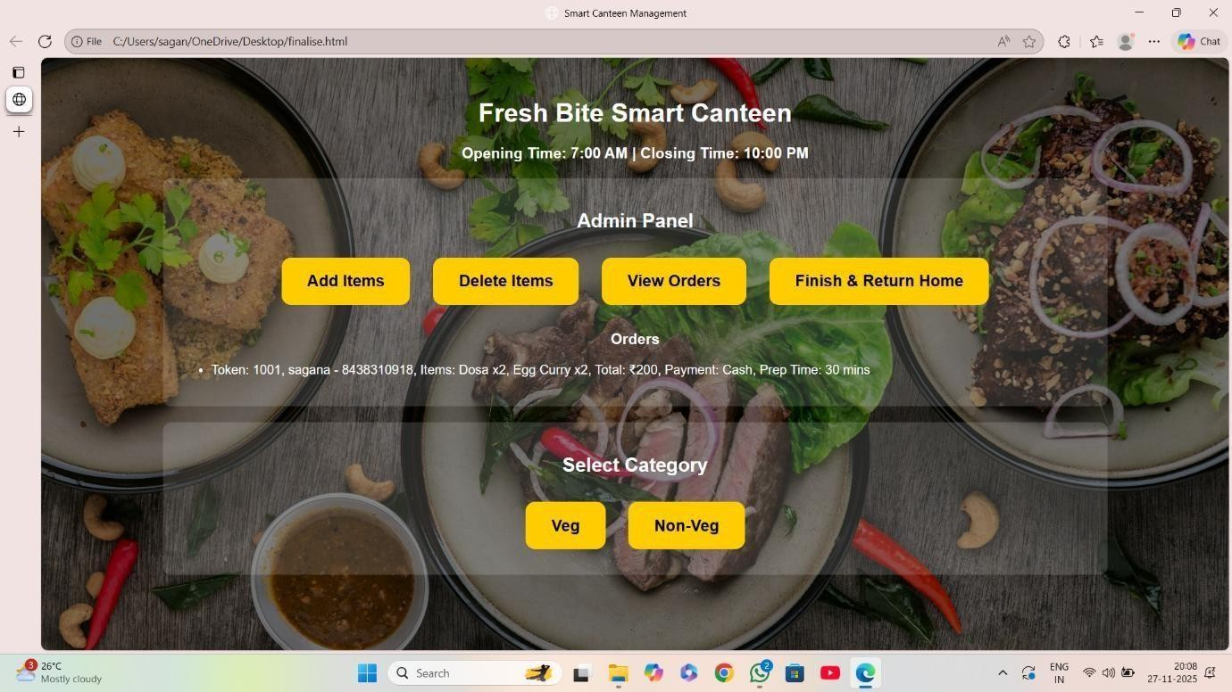
OUTPUT
10. ORDER DETAILS

Slide 26
CONCLUSION
The Smart Canteen System is designed with modular and efficient architecture. UML diagrams clearly represent the system’s structure and behavior. Modules like Menu, Cart, Order, and Payment are well organized and interconnected. User interactions from selecting food to confirming orders are smooth and systematic. The deployment diagram shows real-world implementation across devices and servers. Overall, the system ensures scalability, maintainability, and a user-friendly digital canteen experience.

Slide 27
THANK YOU

